Slide 1
CAR PRICE PREDICTION ANALYSIS
PRESENTED BY
VEENA SRI PM
DATA ANALYTICS AND DATA SCIENCE
RP 33

Slide 2
OBJECTIVE
To perform a comprehensive analysis on understanding Price distribution of car’s and to derive meaningful insights, mainly focusing on identifying trends, understand performance, relations and other factors influencing price to deliver informative observations and uncover opportunities to support data-driven decision-making.
GOAL
Price variation based on car attributes,
On Fuel types, Transmissions, and Engine sizes
Mileage and Year trends
Outliers that may indicate unusual pricing

Slide 3
DATASET OVERVIEW
Records – 2500 rows
Columns – Car ID, Brand, Year, Engine Size, Fuel Type, Transmission, Mileage, Condition, Price, Model
Year ranges between 2000 to 2023
Combination of Luxury and Economy brand
DATA CLEANING
Checked data format
Calculated columns created for clearer analysis
Measures created for precise values

Slide 4
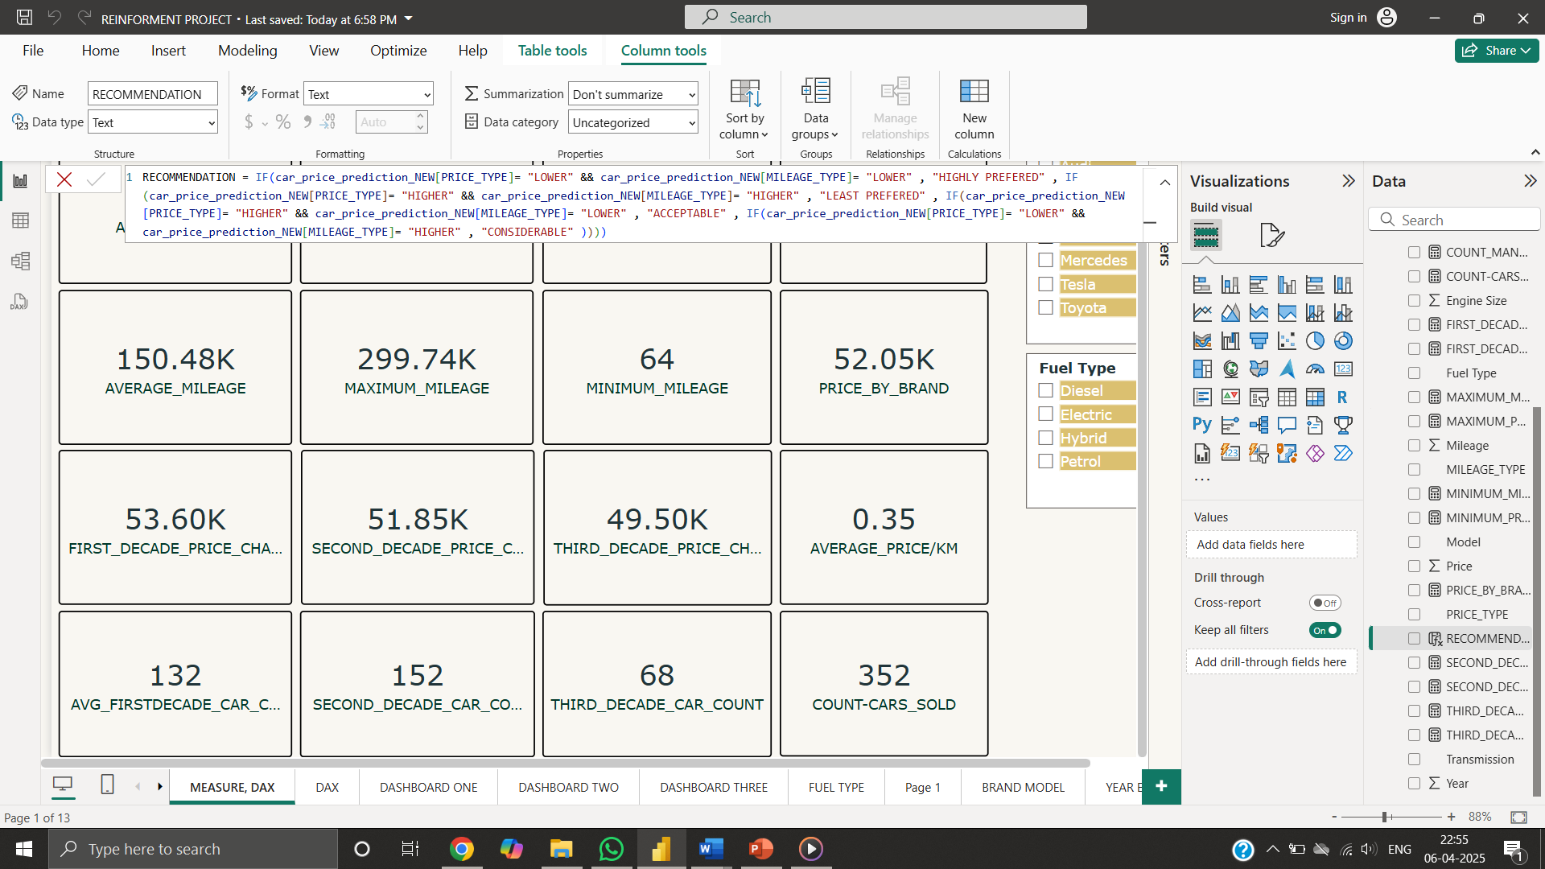
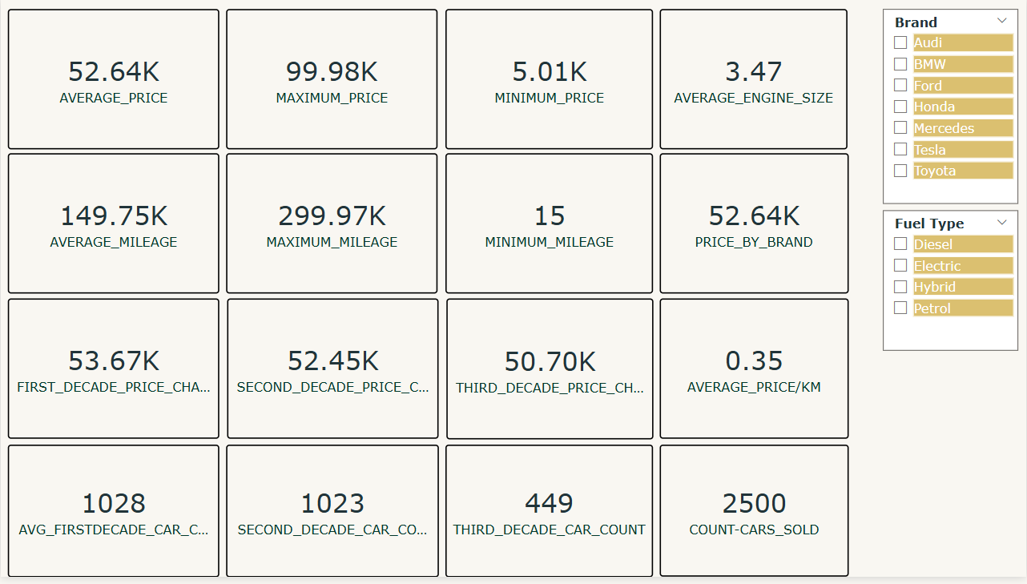
DAX
Price
Mileage
Engine Size
Price by Brand
Segregating Decade’s - Price and Count of car present
Average Price per Kilometre
Count of cars - Transmission
CALCULATED COLUMN
Relating Mileage and Price
Brand category

Slide 5
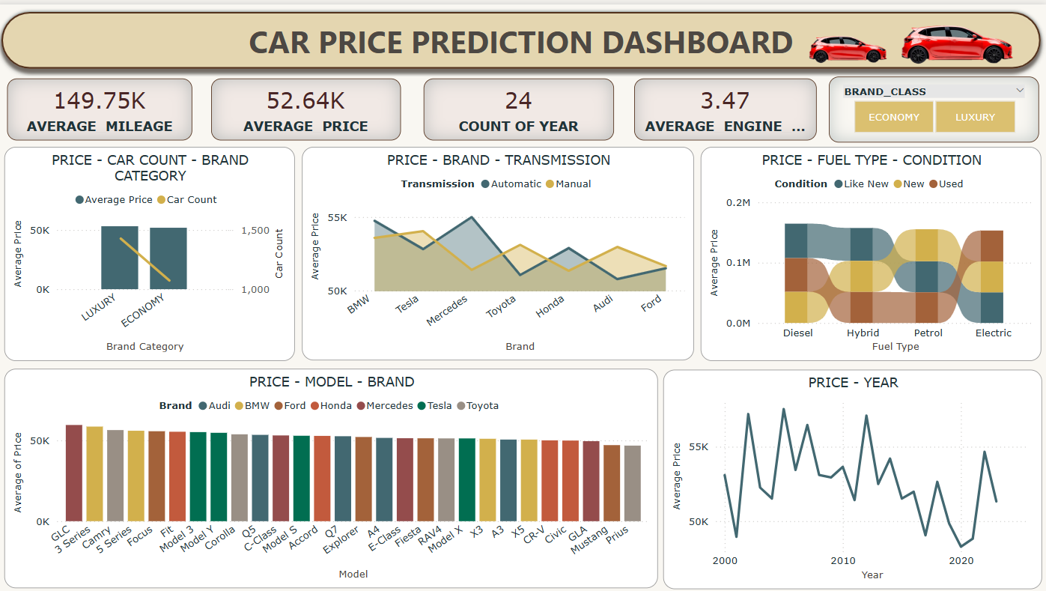

Slide 6
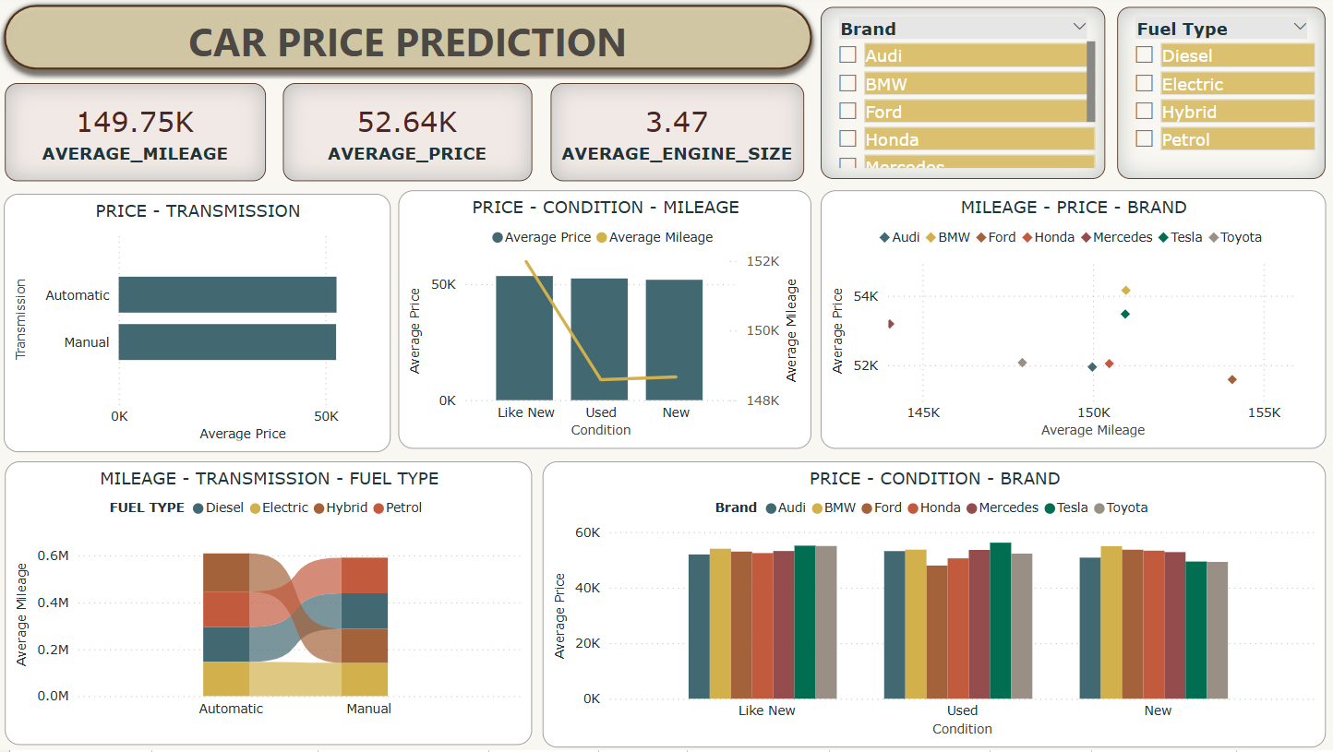

Slide 7
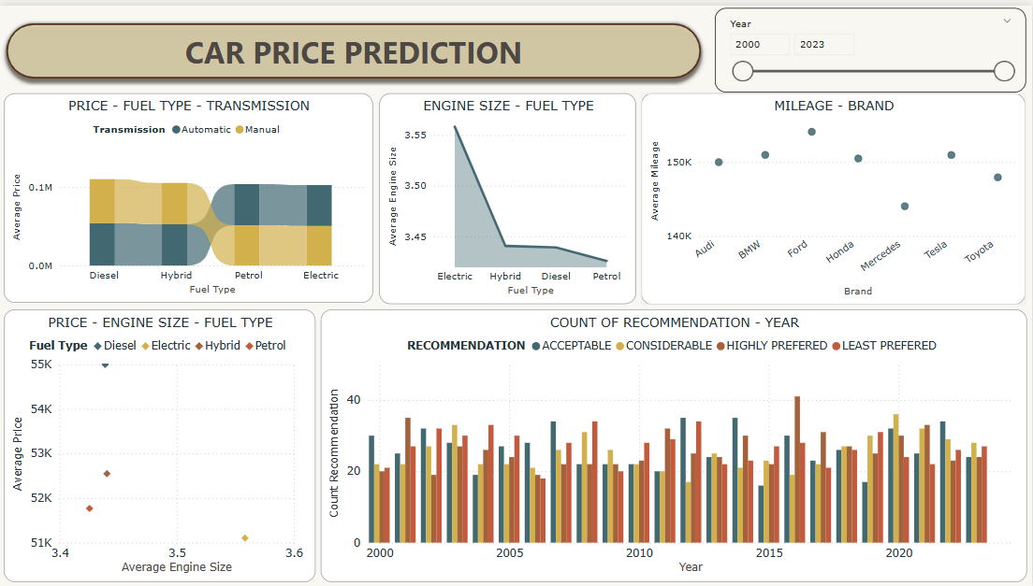

Slide 8
INSIGHTS
Brands generate inverse revenue respect to Transmission
Highest sales - 2005 and lowest sales - 2020
Automatic cars priced slightly higher than Manual cars
Like new cars have higher Price and Mileage
Electric vehicles – higher Engine size - lower Mileage
Irrespective of Condition BMW - preferred

Slide 9
RECOMENDATION
Explanation on Brand strength - Price
Resale explanation help better analysis
Details on safety features and other amenities
Customer perspective on preferences over Brands
Geographic location contribution on Price
Target newer, fuel-efficient automatic cars

Slide 10
CONCLUSION
Manual cars are preferred than Automatic cars
Pricing could depends on several other factors -
Manufacturing cost
Inflation
Dealer profit margin
Insurance type

Slide 11

THANK YOU

